Slide 1
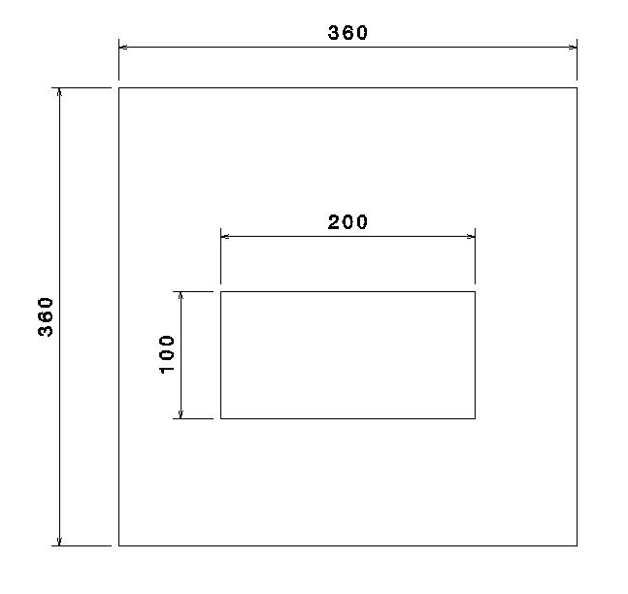
AIP
IA

Slide 2
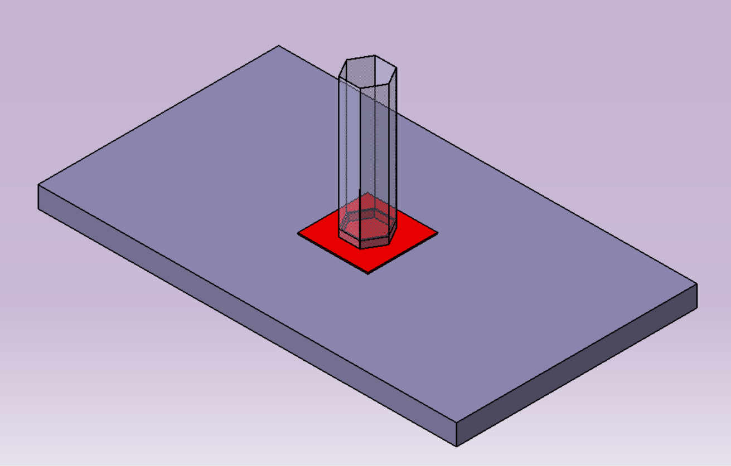
Cell of the AIP
AIP
Glue that runs up along the walls of the honeycomb
Glue spread on the AIP

